Slide 1
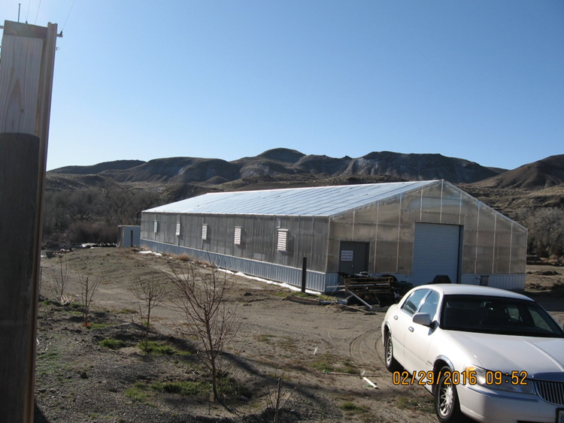
Washoe County Board of Adjustment
April 6, 2017
Amendment of Conditions Case Number WAC17-0002 (Evans Greenhouses) for Administrative Permit Case Number AP12-003 as previously amended by Amendment of Conditions Case Number AC15-002

Slide 2
Case Description
For possible action, hearing and discussion to approve an amendment to the conditions of approval for Administrative Permit Case Number AP12-003 (as previously amended by Amendment of Conditions Case Number AC15-002) which approved the construction of two large greenhouses for commercial purposes on the subject site. Only one of the greenhouses was actually constructed. The second greenhouse will not be constructed and a proposed condition of this approval is that the applicant remediates the site of the second greenhouse.

Slide 3
Case Description (2)
Additionally, the current amendment of conditions requests: 1) to remove all conditions of approval that apply to the previously approved commercial use of the project because the greenhouse will be used only as an accessory use to the residential dwelling; 2) to prohibit commercial use of the greenhouse that has already been constructed on the subject site; and 3) to allow the greenhouse that has already been constructed to remain as a detached accessory structure that is larger than the existing residential dwelling unit.

Slide 4
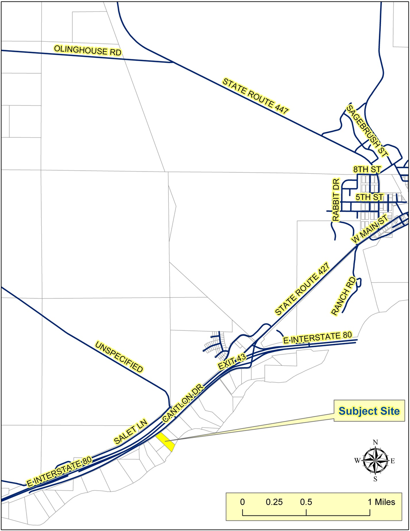
Vicinity
Map

Slide 5
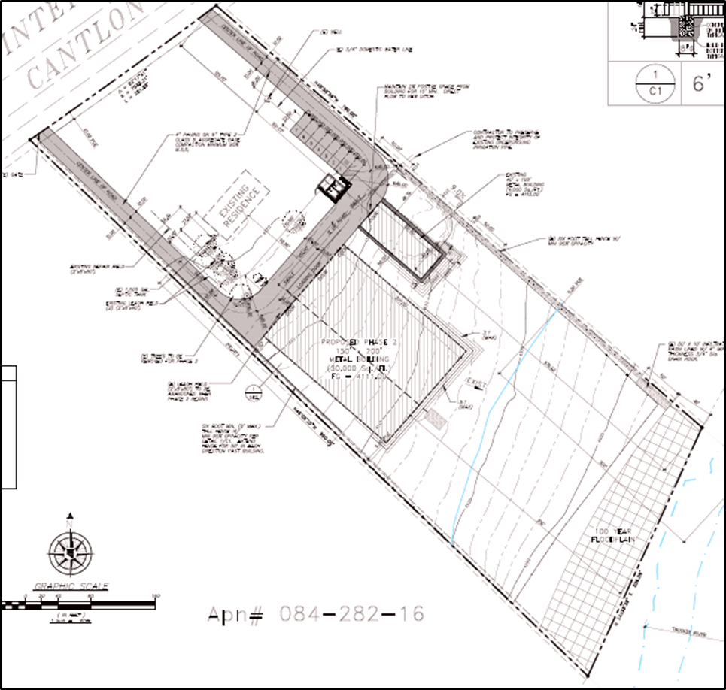
Site
Plan

Slide 6
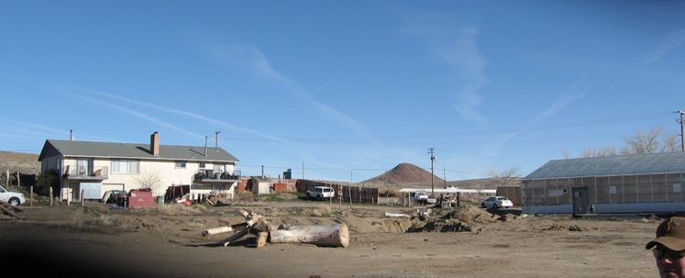
Current Photo of Subject Site

Slide 7
Current Photo of Subject Site

Slide 8
Background
2012: AP12-003 Approved to allow two large commercial greenhouses
4000 square foot greenhouse constructed but never received final inspection (the building permit expired in 2016)
2015: AC15-002 Approved to extend time to construct both greenhouses for an additional two years.

Slide 9
Current Request
maintain the existing greenhouse as a detached accessory structure to the existing residential dwelling
eliminate all commercial use of the existing greenhouse
clean-up and restoration of the substantial disturbance of the site
No lighting at night

Slide 10
Analysis
Substantial reduction in the intensity of use of the existing greenhouse
Commitment of the applicant to restore and stabilize the site
Condition to prohibit light emission at night

Slide 11
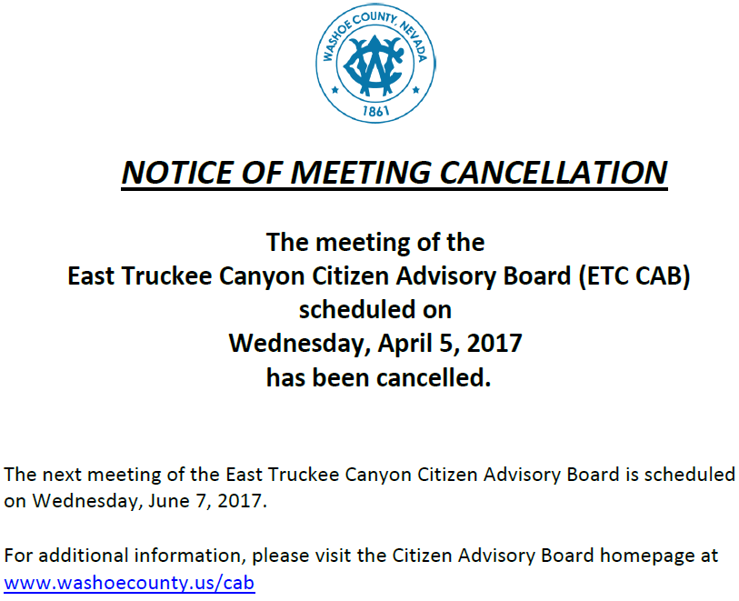
Citizen Advisory Board

Slide 12
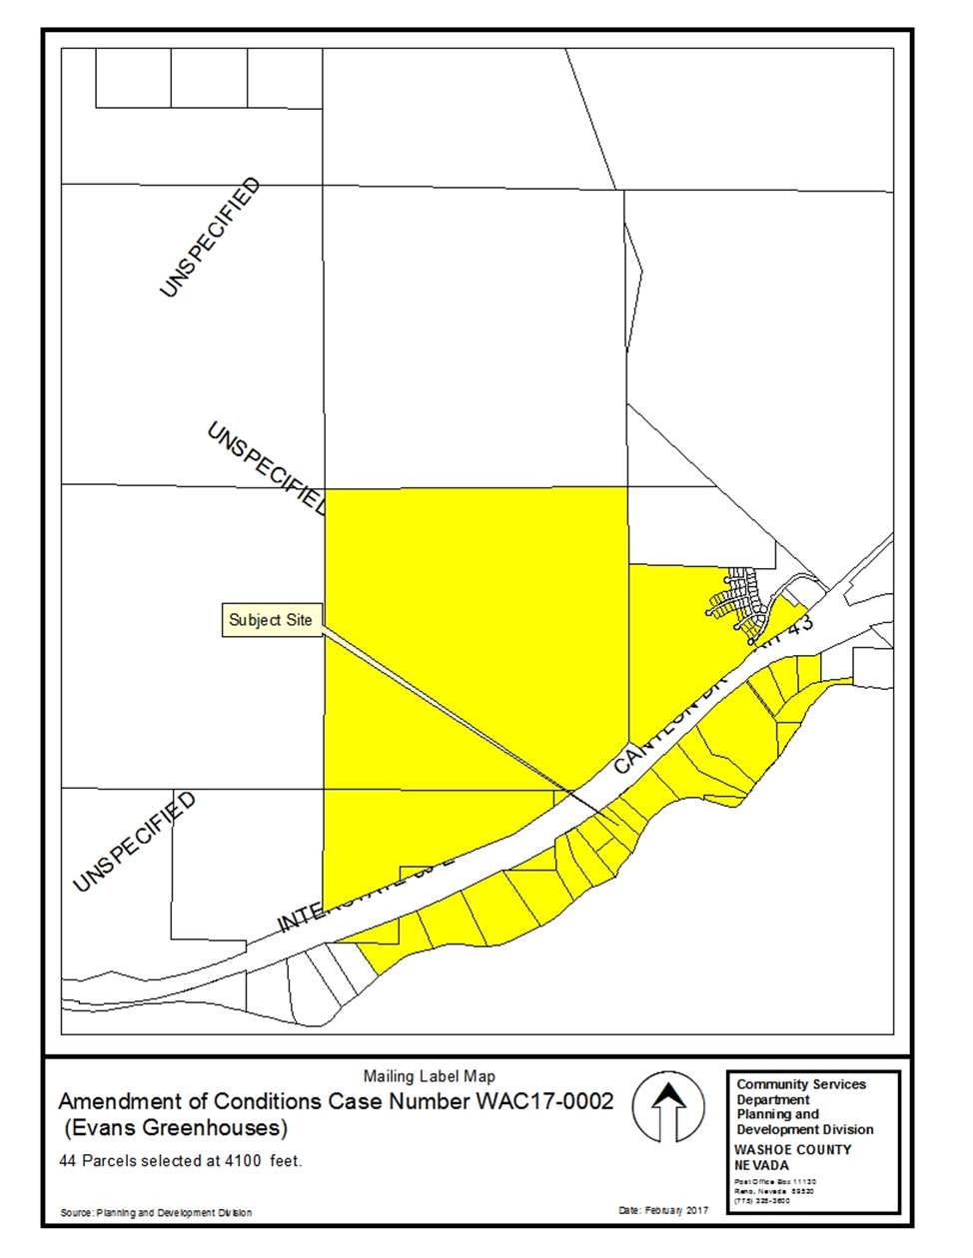
Public
Notice

Slide 13
Conditions of Approval
Have been modified to address the new proposed use of the existing greenhouse as accessory to the existing residence only

Slide 14
Administrative Permit Findings
1. Consistency. That, as conditioned, the proposed use is consistent with the action programs, policies, standards and maps of the Master Plan and the East Truckee Canyon Area Plan;
2. Improvements. That, upon compliance with the conditions of approval imposed by the Board of Adjustment, adequate utilities, roadway improvements, sanitation, water supply, drainage, and other necessary facilities have been provided, the proposed improvements are properly related to existing and proposed roadways, and an adequate public facilities determination has been made in accordance with Division Seven;
3. Site Suitability. That the site is physically suitable for two greenhouse structures for the commercial production of crops, and for the intensity of such a development;
4. Issuance Not Detrimental. That, as conditioned, issuance of the permit will not be significantly detrimental to the public health, safety or welfare; injurious to the property or improvements of adjacent properties; or detrimental to the character of the surrounding area.

Slide 15
Recommendation
Amendment of Conditions Case Number WAC17-0002 is being recommended for approval with conditions. Analysis of the reduction in intensity of the proposed use leads staff to the conclusion that all applicable findings of fact can be made.

Slide 16
Possible Motion
I move that, after giving reasoned consideration to the information contained in the staff report and information received during the public hearing, the Board of Adjustment approve Amendment of Conditions Case Number WAC17-0002 for Administrative Permit Case Number AP12-003 with amended conditions of approval as included at Exhibit A, having made all four findings in accordance with Washoe County Code Section 110.808.25

Slide 17
Questions?

